Slide 1
The Hydrogen Atom
Probabilities and Probabilistics

Slide 2
A Catastrophe

Slide 3
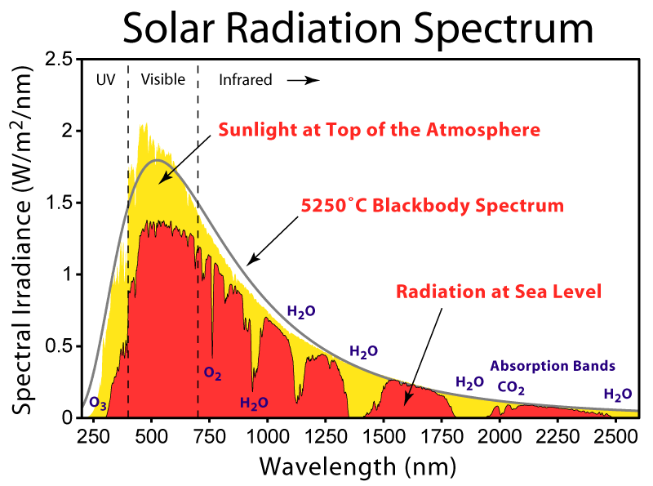
Blackbodies
If you shine a light on any object, they can either absorb, reflect, or transmit that light.
Blackbodies are only allowed to absorb and re-emit light.
They pretty accurately model celestial radiation, even for our sun!

Slide 4
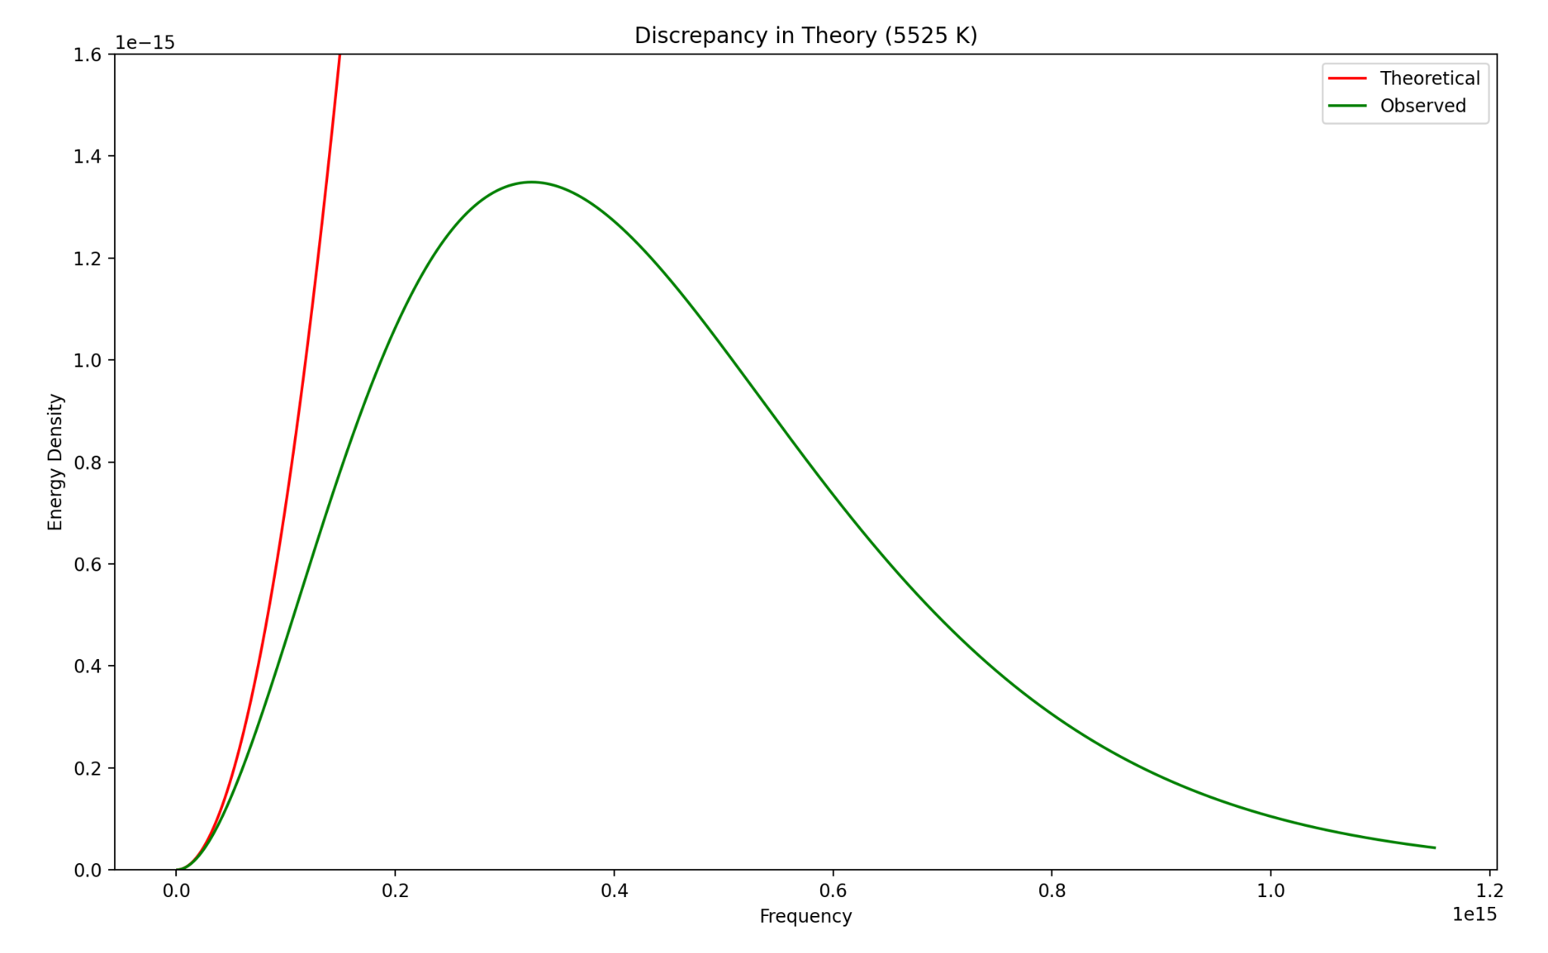
Blackbody Energy
A blackbody gains energy by absorbing light of different frequencies.
How much of the energy is due to light of a specific frequency?
Lord Rayleigh, and later Jeans, came up with an expression that works well for low frequency emissions.
Why does it fail for higher frequencies?

Slide 5
Bite-Sized Pieces

Slide 6
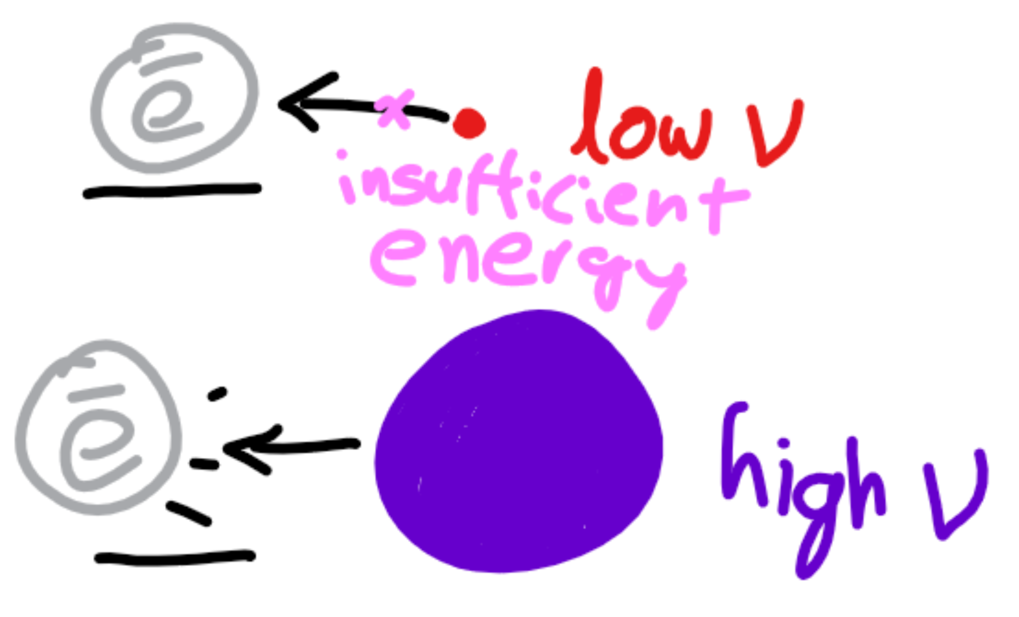
Photoelectric Effect
For decades, people have been using light to blast electrons off of metals.
They noticed higher frequency lights had more success in removing these electrons.
This led to the theory that light was made of particles (photons) whose individual energies were proportional to the frequency of the light.

Slide 7
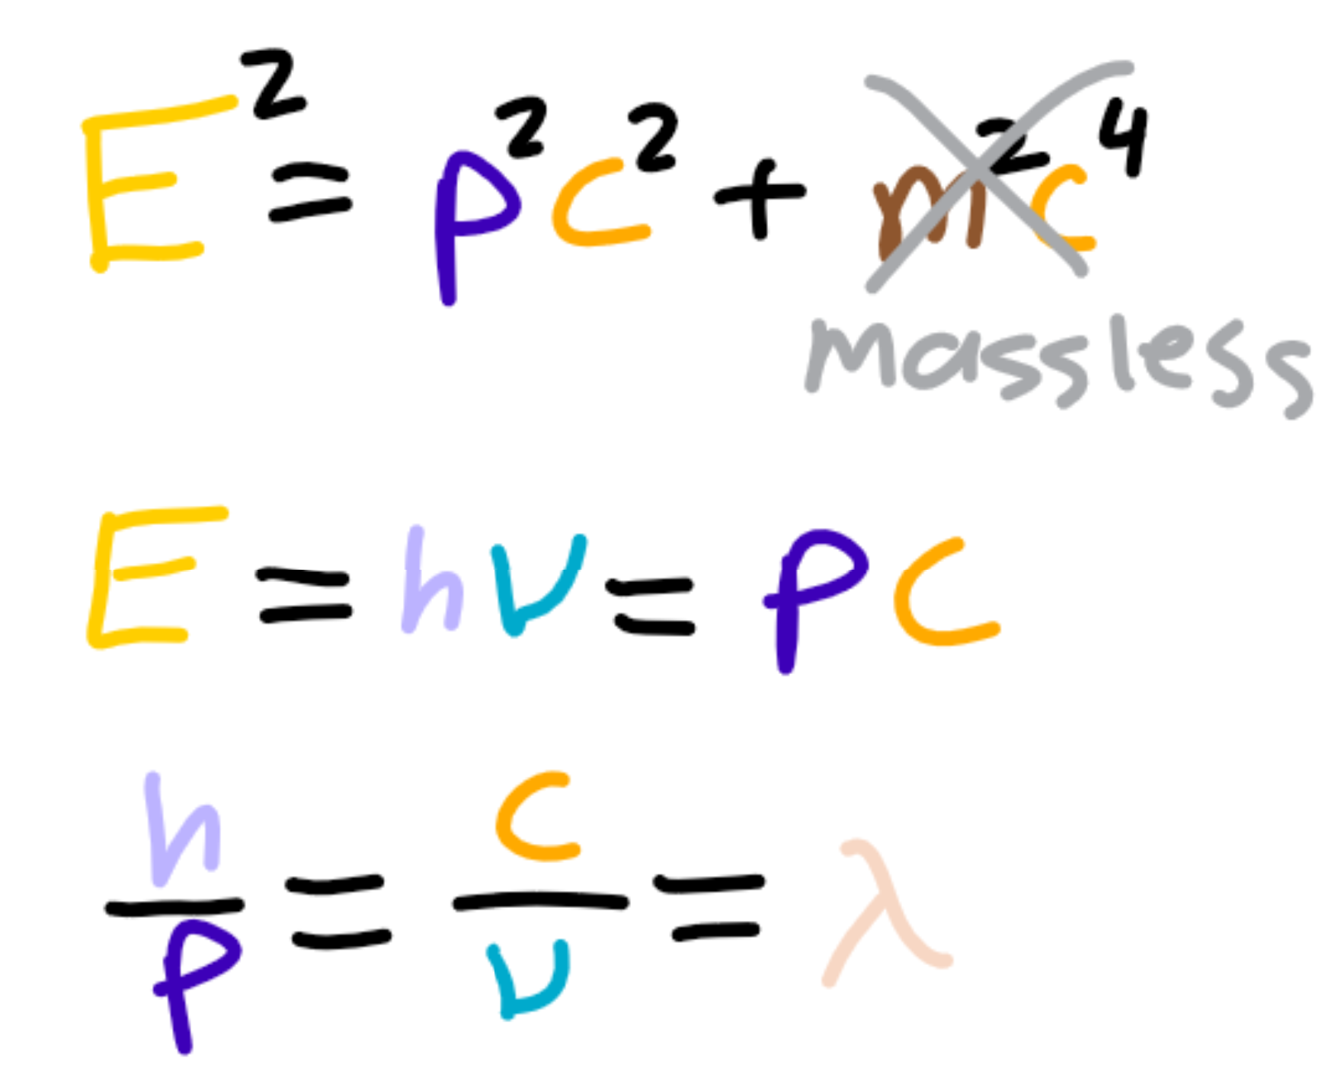
De Broglie Wavelength
We can compare the photon energy with Einstein’s famous equation for massless particles.
A little rearranging gives us the momentum in terms of the frequency.
The product of wavelength and frequency is the speed of the wave, giving us a relation between wavelength and momentum as well.

Slide 8
Coconuts and Castaways

Slide 9
Energy Distribution at Equilibrium
A simple model:
Consider a system with a 1000 particles.
Let each particle start with 5 ‘units’ of energy.
Every time two particles collide with each other, one particle gives the other particle 1 unit of energy.
After a long amount of time, how will the energy be distributed?
Uniformly?
Linearly?
Exponentially?

Slide 10
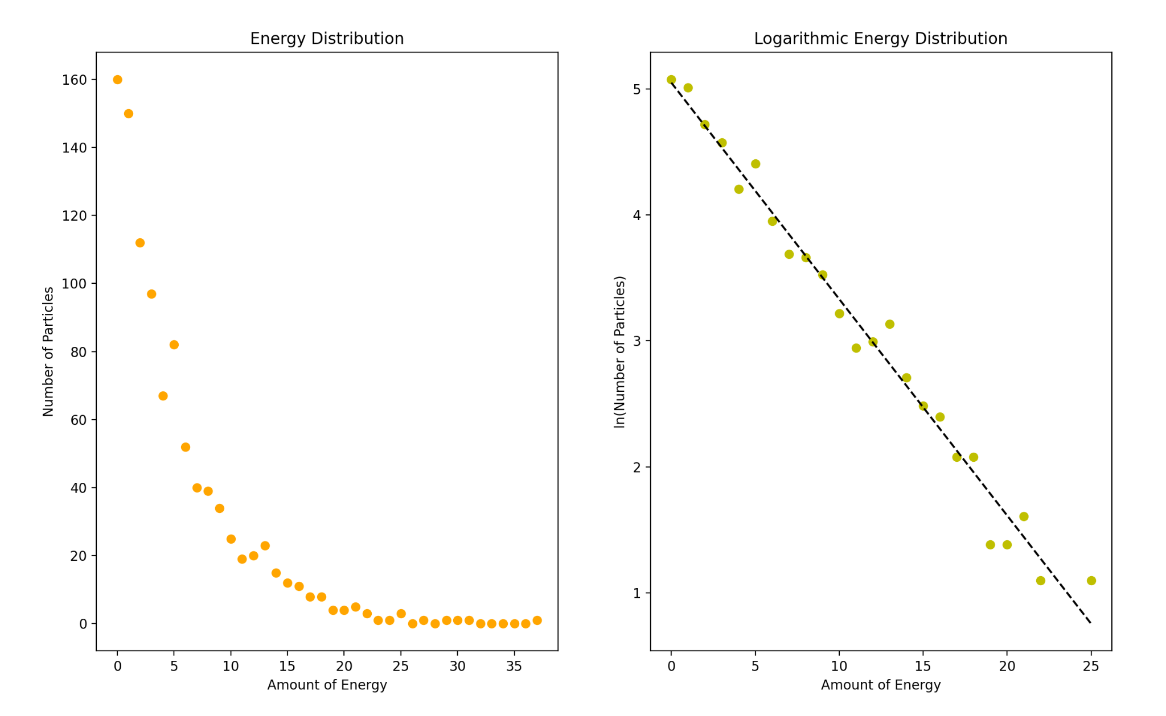

Slide 11

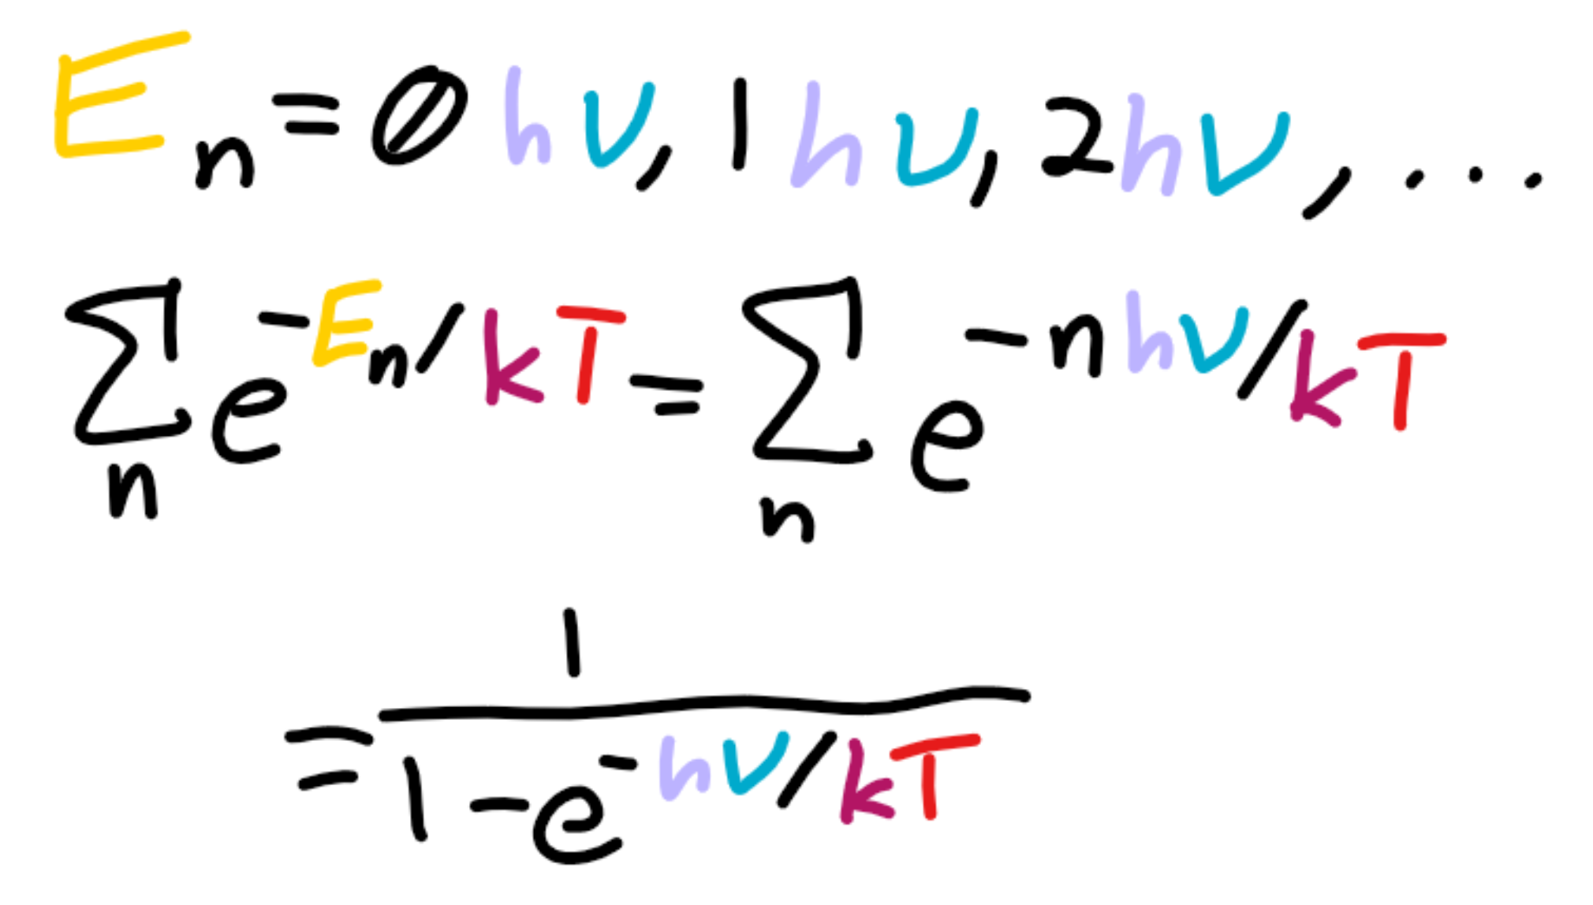
Planck Distribution
Boltzmann derived an exponential decay formula based on energy.
Planck theorized the possible energies were integer multiples of the frequency.
The sum of the probabilities formed an infinite geometric series.
The average thermodynamic energy is related to the derivative of this sum.

Slide 12
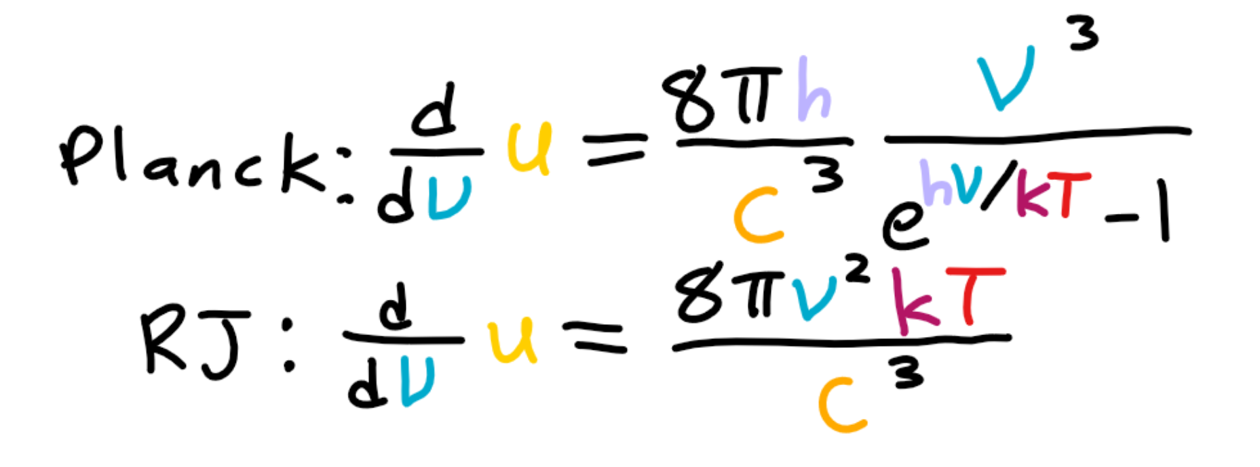
Revised Blackbody Energy
Planck used his distribution to derive a new law for blackbody energy.
Unlike the Rayleigh-Jeans law, his law postulates that at a certain frequency (2.821kT), the energy contributed by higher frequencies begins decreasing since they are less likely to occur.

Slide 13
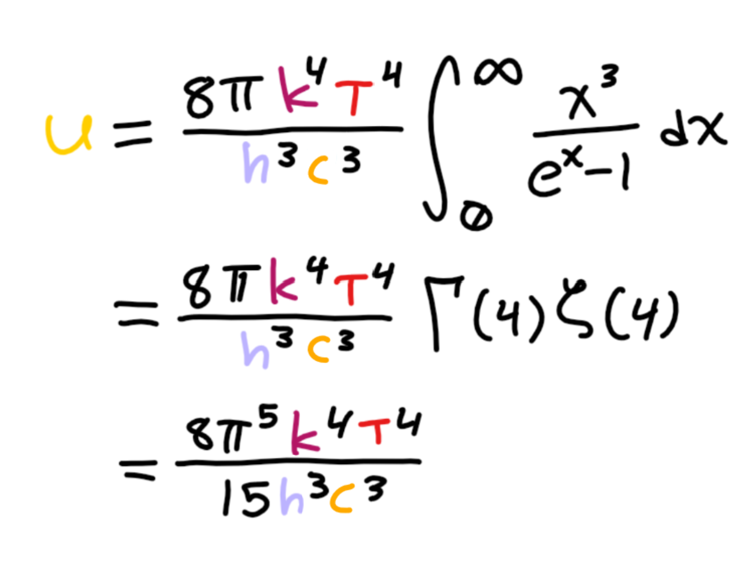
Total Blackbody Energy
We can actually integrate Planck’s law across all frequencies to find the total amount of energy stored in the blackbody.
Integrating the Rayleigh-Jeans law gives an infinite amount of energy in the blackbody, which is obviously false.

Slide 14
Imaginary Numbers are Real

Slide 15
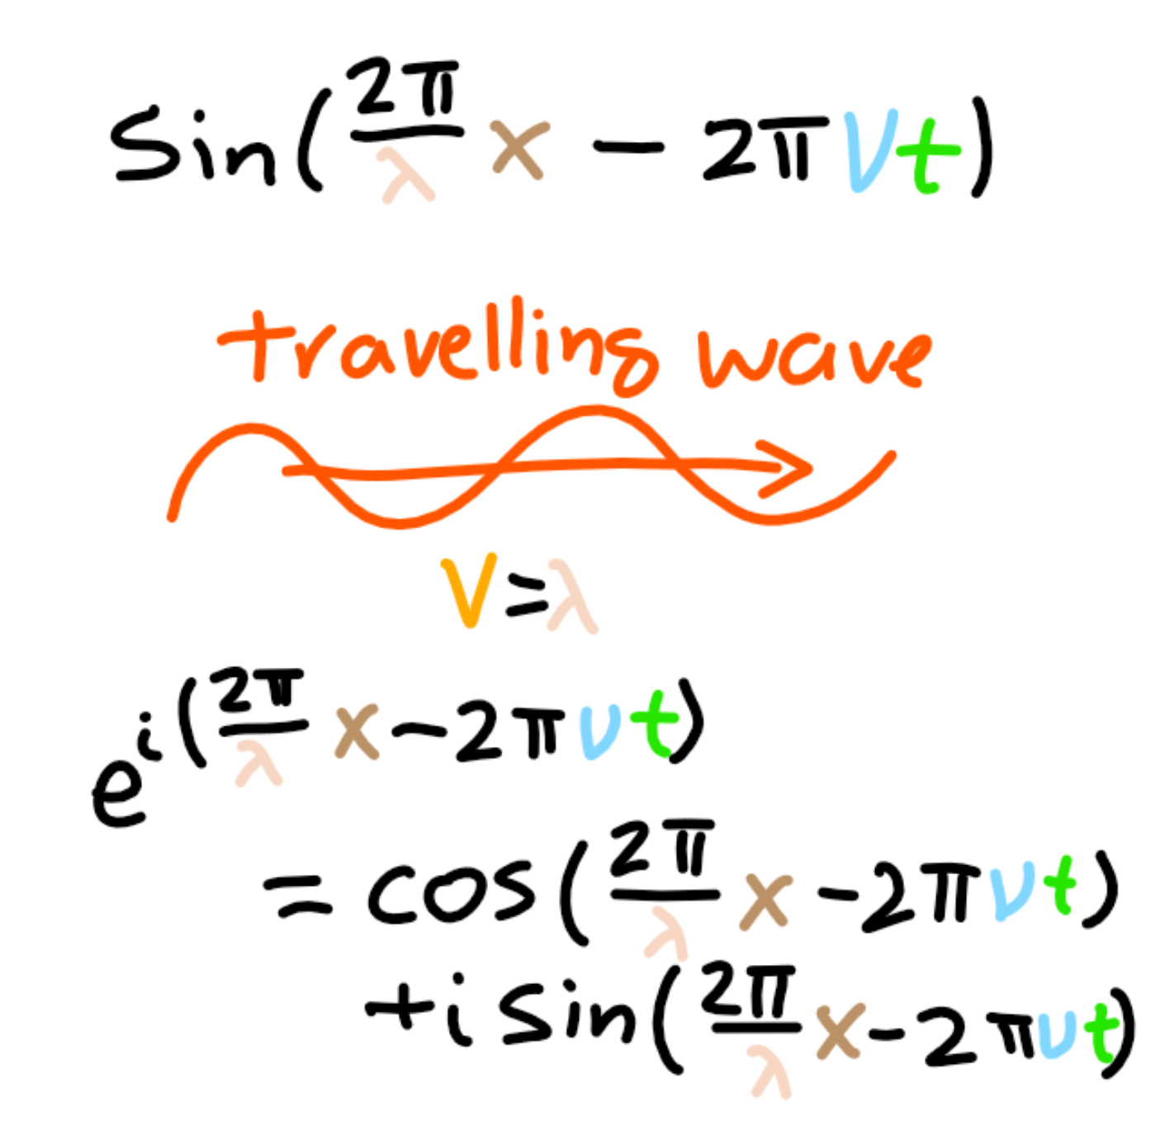
Wave Equation
All waves can be constructed from combinations of sine waves.
However, sine is not a great function to work with since its derivative, which tells us the velocity of the wave, is another function (cosine).
To make computations easier, we can use an imaginary exponential since the derivative is the same function times some scale factor.

Slide 16
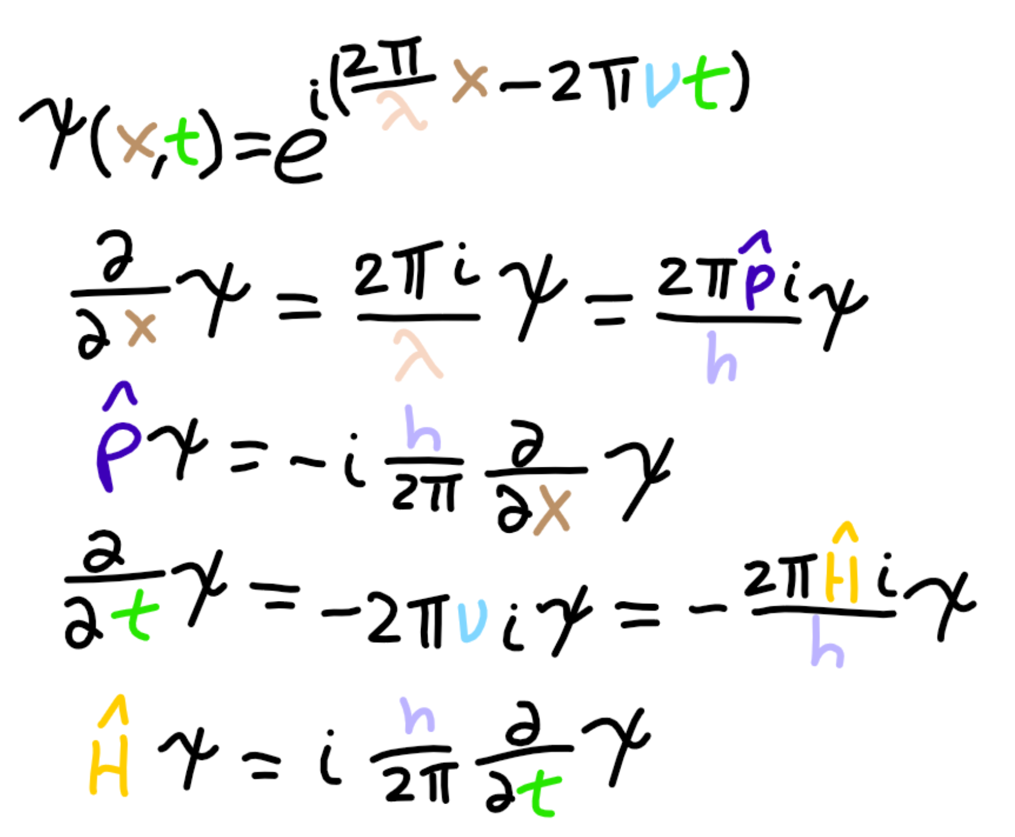
Momentum and Energy
If we differentiate a plane wave with respect to x, we can rearrange the resulting scale factor to be a function of momentum.
Similarly, if we differentiate with respect with t, we can rearrange the resulting scale factor to be a function of energy.
The latter is the time-dependent Schrödinger equation.

Slide 17
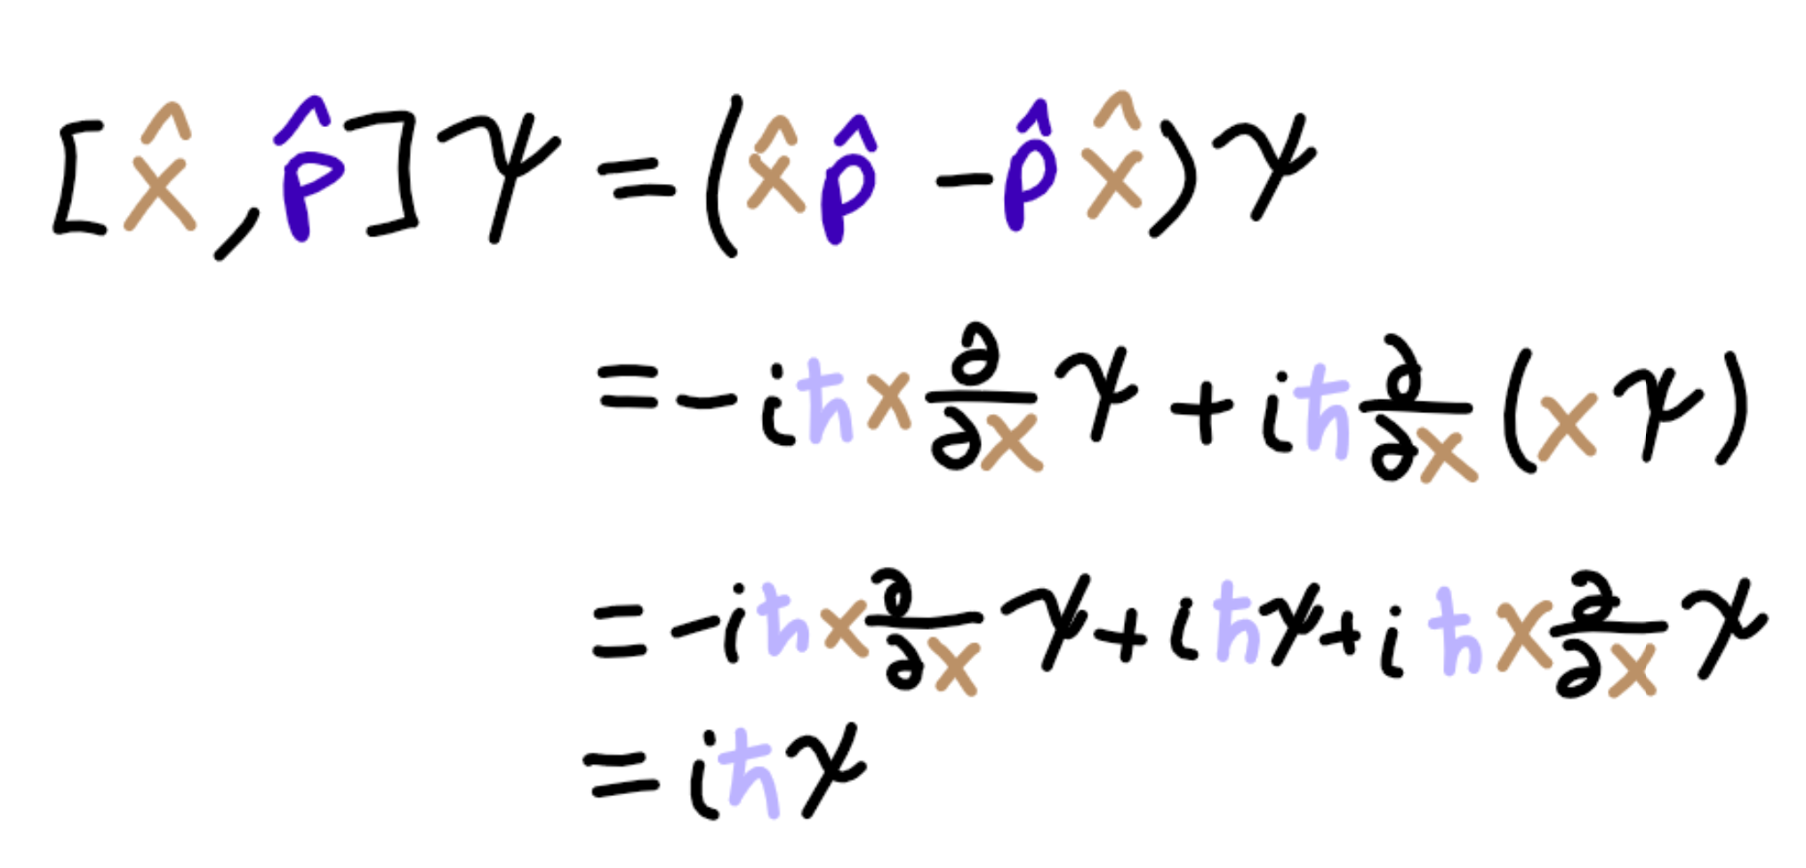
Commutators
The quantities A and B commute if AB-BA=0. The quantity AB-BA is called the commutator of A and B.
If A and B do not commute, then this means we have a trade-off between measurements of A and B.
The commutator of momentum and position is iℏ, meaning measurements between momentum and position tradeoff (uncertainty principle).

Slide 18
Hydrogen Atom

Slide 19
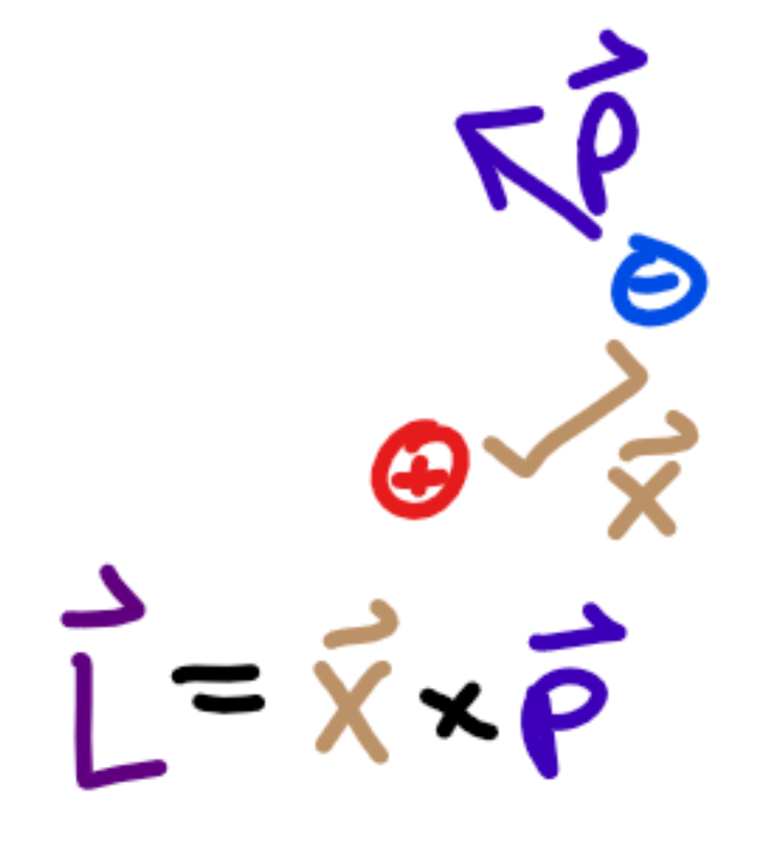
Angular Momentum
Angular momentum is sort of momentum about an axis of rotation.
For an electron rotating about the nucleus, the value of angular momentum is the (cross) product between position from the nucleus and the momentum of the electron.
We denote the angular momentum L, and angular momentum about the z-axis L_{Z}.

Slide 20
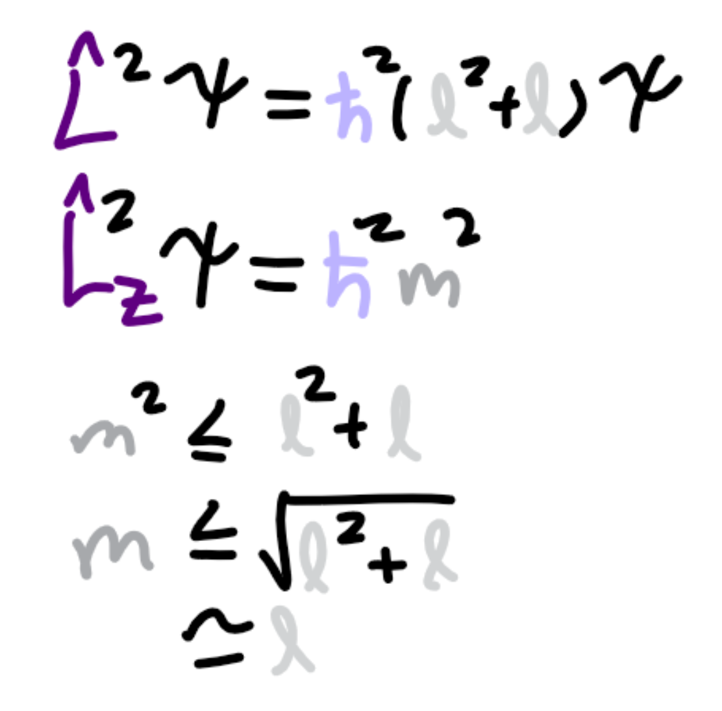
Orbitals and Degeneracies
We can exploit commutators to get relations for L² and L_{Z}.
Specifically, we get the L² operator is identical to multiplying by ℏ²(l²+l) for some positive integer l, and L_{Z} is identical to multiplying by ℏm for some m. (In position space.)
Since L_{Z}² ≤ L² by definition, we have the restriction m² ≤ l²+l, so |m| ≤ l.

Slide 21
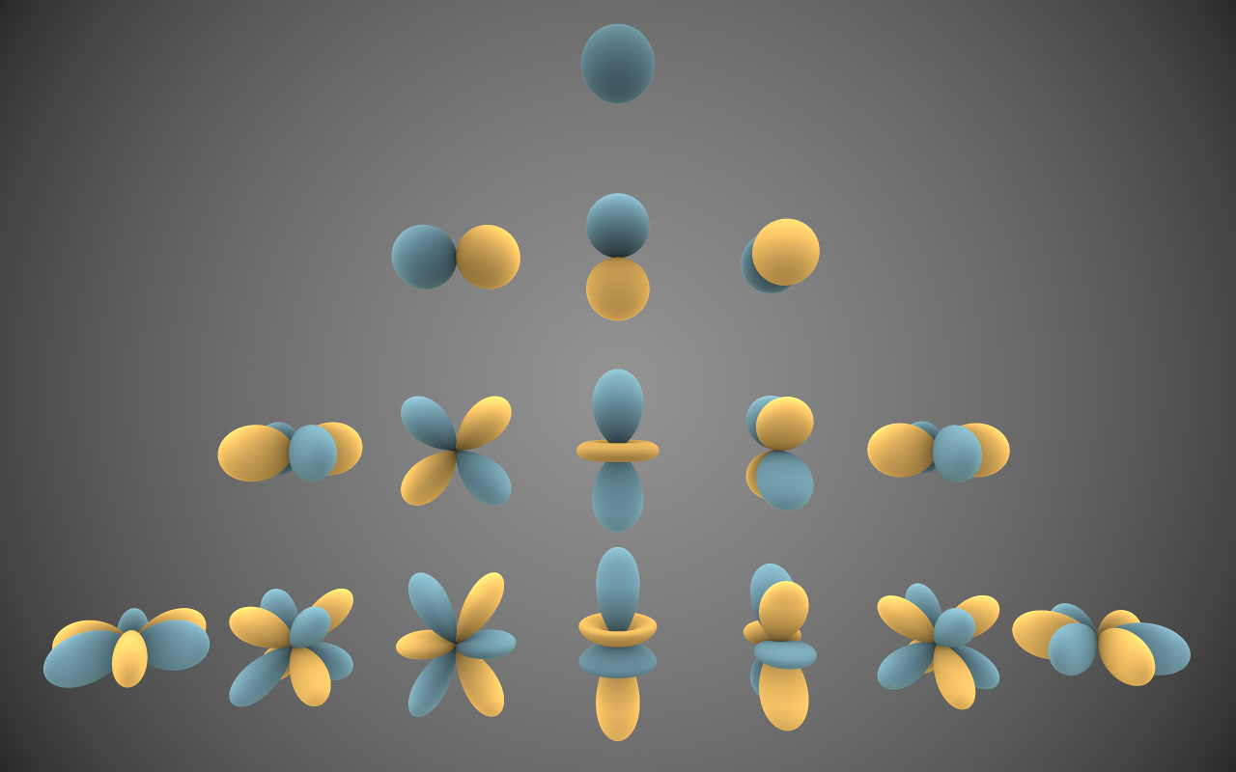
Spherical Harmonics
We can also use the fact that momentum is -iℏ∇ to get solvable equations for the where an electron is likely to be in terms of of l and m.
These solutions are the spherical harmonics, which define the shape of orbitals.

Slide 22
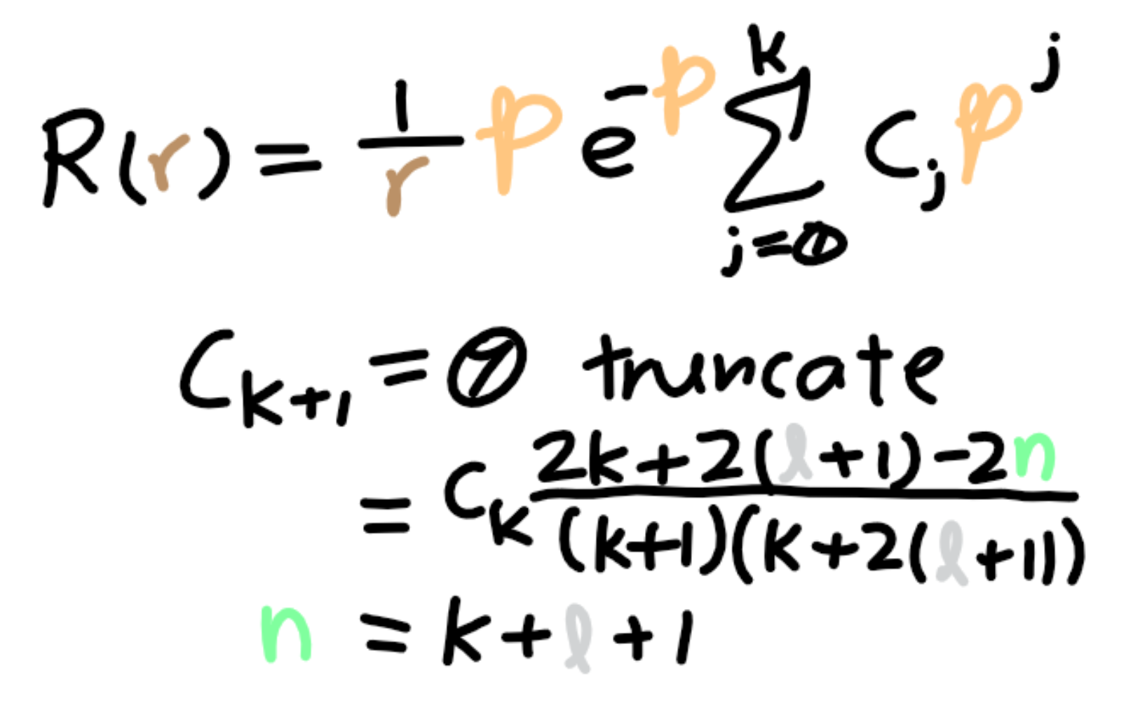
Solving the Radial Equation
We also want to know how energy is related to the other quantities.
The radial equation tells us how the energy due to electron-proton attraction affects the where we find the electron.
Its solution is a sum that needs to be truncated, where the maximum quantity is n=k+l+1 for some natural number k.
The quantity n is related to the energy and must always be at least one larger than l.

Slide 23
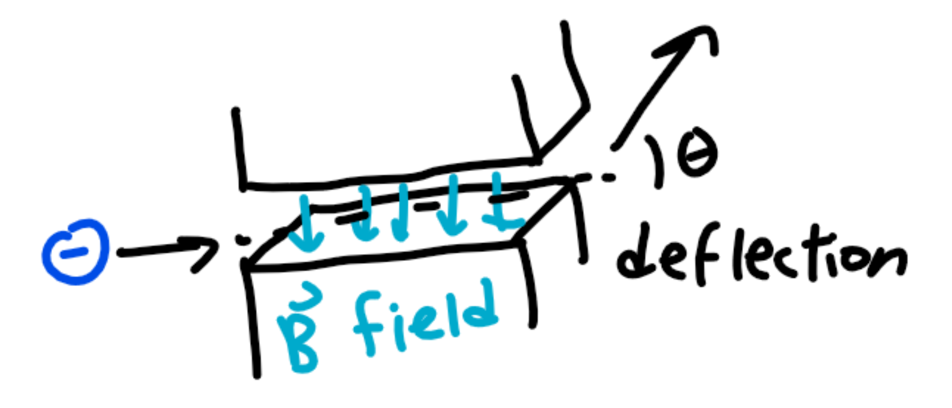
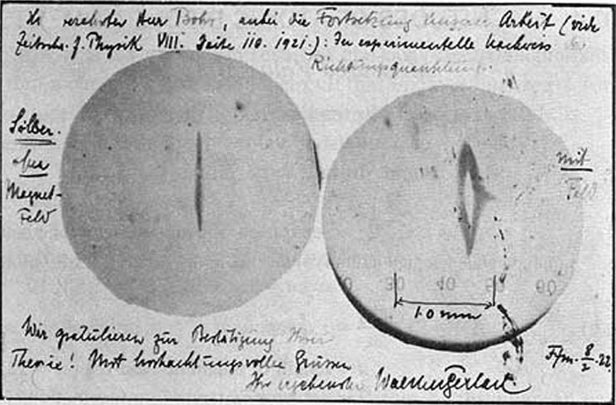
Spin
For a time, it seemed as if n, l, and m fully accounted for the hydrogen atom electron.
Stern-Gerlach revealed electrons had an additional magnetic momentum independent of these quantum numbers.
The spin quantum number, s, was born to account for this.

Slide 24
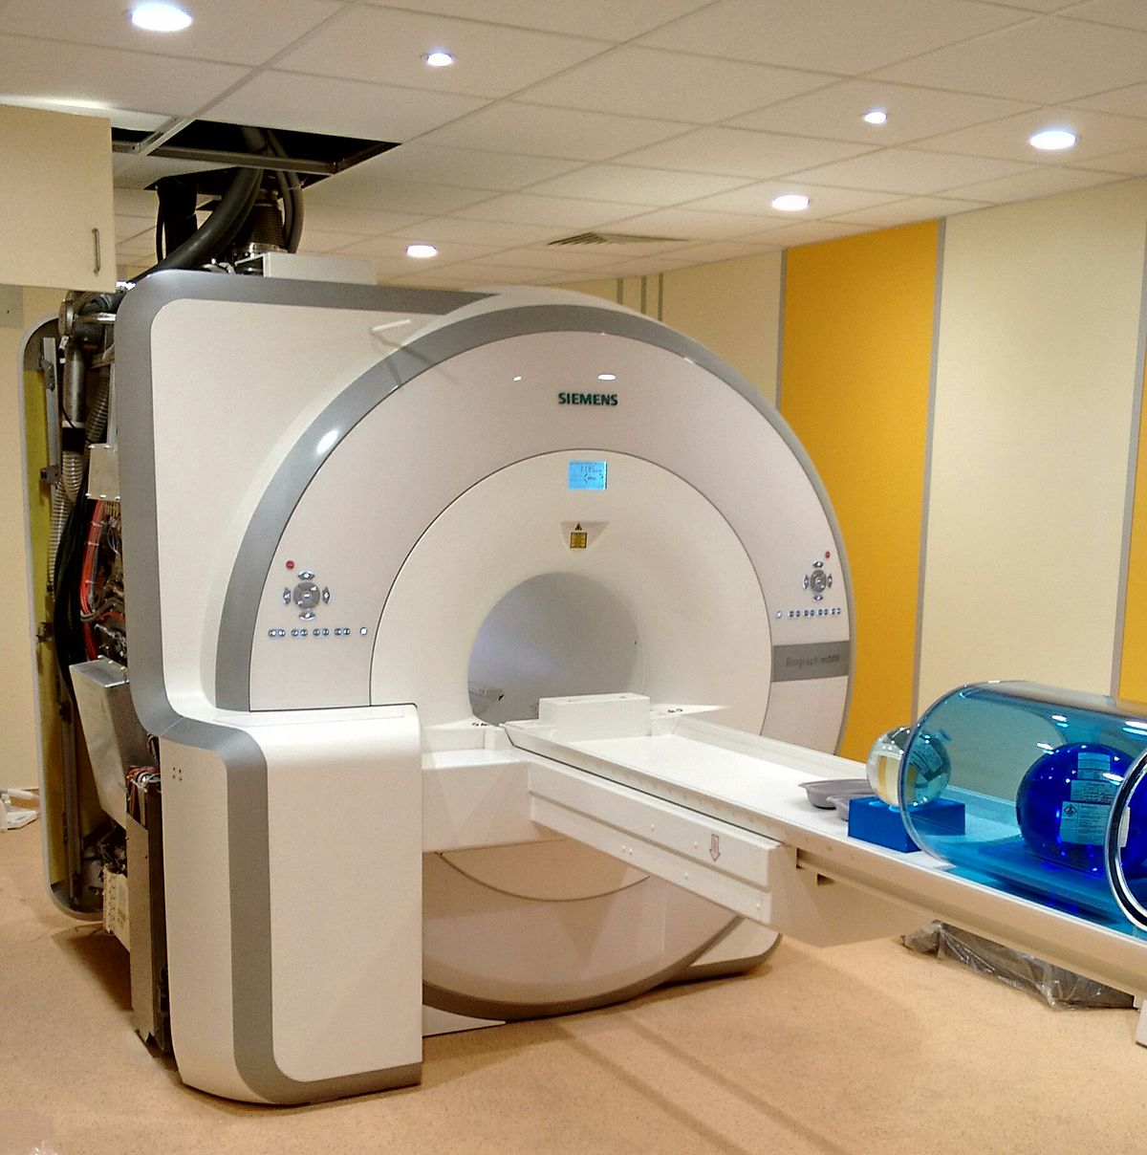
Rabi Oscillations
We can tune magnetic waves to target the spin of an electron.
Specific frequencies of magnetic waves near an electron will cause them to vibrate intensely.
These Rabi Oscillations are the basis of imaging technology such as magnetic resonance imaging (MRI).

